Slide 1

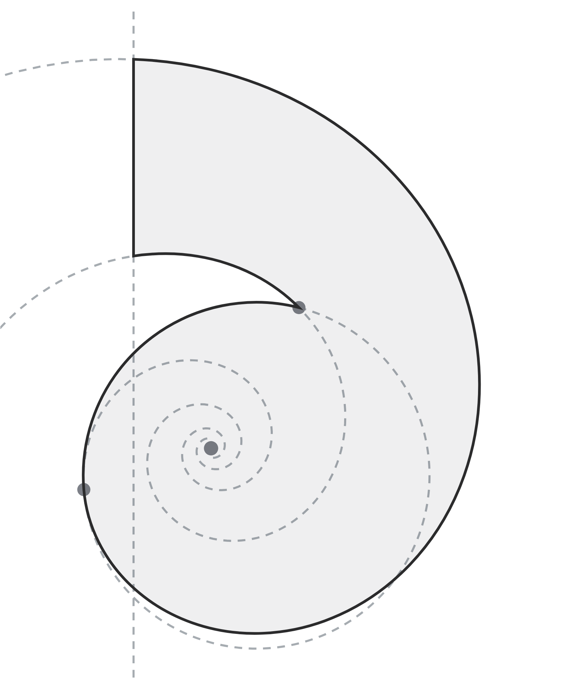
Brand guidelines.
Logo, colour, type,
layout and templates.
[ VERSION 1.0 · OCTOBER 2026 ]
COMPASS ENERGY PTE. LTD., TRADING AS DESKELY
DESKELY.COM/COMPANY/MEDIA

Slide 2

[ CONTENTS ]
Contents. Six chapters, one system.
01
Logo
Versions, construction, clear space, size, backgrounds, misuse
02
Colour
Palette, values, contrast and proportion
03
Typography
Typefaces, scale and use
04
Layout
The frame, spacing and rules
05
Graphics
Line work, labels and icons
06
Templates
Print, email, social and screens
DESKELY BRAND GUIDELINES · OCTOBER 2026
02

Slide 3
[ 01 ]
Logo
A spiral mark drawn from one logarithmic curve, and the name set in DM
Sans ExtraBold. Always use the supplied files.
DESKELY BRAND GUIDELINES
03

Slide 4



[ 01 · LOGO ]
[ THE PRIMARY LOCKUP ]
DESKELY BRAND GUIDELINES · OCTOBER 2026
04

Slide 5














[ 01 · VERSIONS ]
Versions. Ten files, each in SVG, PNG and vector
PDF.
Logo
Logo, reversed
Stacked
Stacked, reversed
Wordmark
Mark
App icon
App icon, light
DESKELY BRAND GUIDELINES · OCTOBER 2026
05

Slide 6


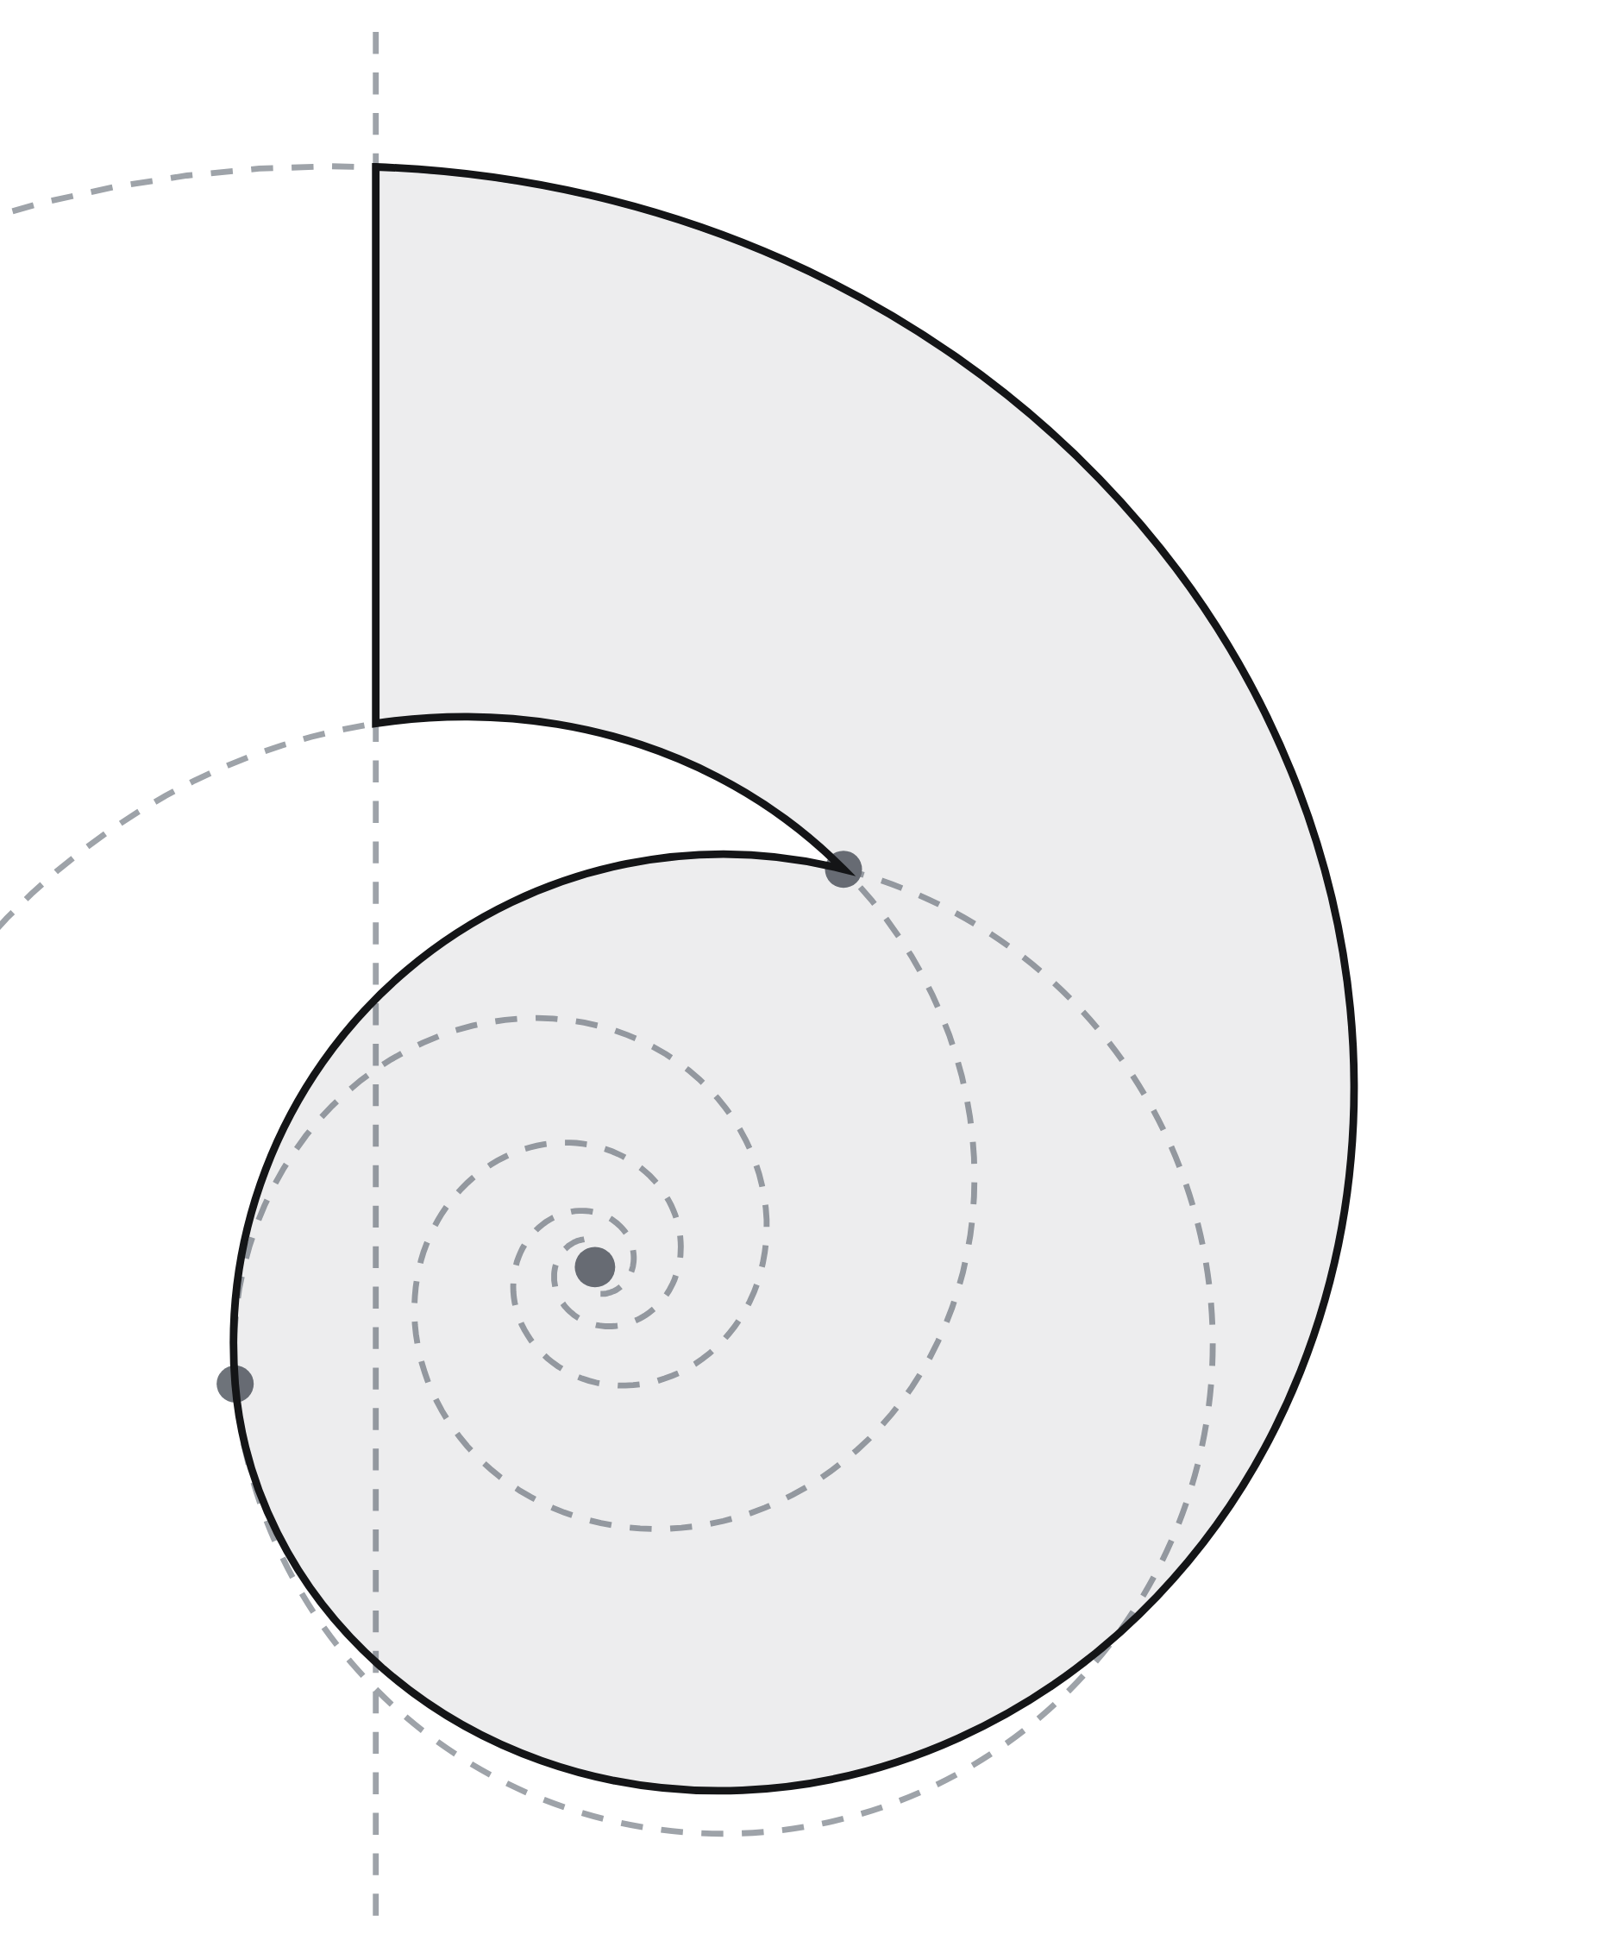
[ 01 · CONSTRUCTION ]
Construction. One spiral, three
rules.
01
Outer edge
A logarithmic spiral, the curve of a nautilus shell, growing 1.45
times each quarter turn.
02
Inner edge
The same spiral at half scale, so the band tapers like a shell.
03
Lip
One circle, tangent to the bowl and passing through the tip of the
notch.
04
Stem
A straight vertical cut that starts the spiral, square at the top.
The geometry is fixed. Never redraw, trace or adjust the mark.
DESKELY BRAND GUIDELINES · OCTOBER 2026
06

Slide 7










[ 01 · CLEAR SPACE AND SIZE ]
Clear space and size. One mark of space on
every side.
Logo
96 px wide on screen, 25 mm in
print
Mark and app icon
16 px on screen, 5 mm in print
[ 1 × MARK ]
Below the minimum
Use the mark on its own
DESKELY BRAND GUIDELINES · OCTOBER 2026
07

Slide 8











[ 01 · BACKGROUNDS AND MISUSE ]
Backgrounds and misuse. Four grounds, and the
logo as supplied.
WHITE
PAPER
INK
CHARCOAL
×
Don’t stretch or squash it
×
Don’t recolour it
×
Don’t rotate it
×
Don’t add shadows or
effects
×
Don’t outline it
×
Don’t place it on mid-grey
DESKELY BRAND GUIDELINES · OCTOBER 2026
08

Slide 9
[ 02 ]
Colour
Ink on white, with a scale of greys. Colour is rare: one blue, for links only.
DESKELY BRAND GUIDELINES
09

Slide 10

[ 02 · PALETTE ]
Palette. Core, neutrals and one functional colour.
Ink
White
Paper
Charcoal
Link
Logo, headlines and text
Main ground
Grey grounds and bands
Dark panels and decks
Text links only, never as a fill
HEX #141517
RGB 20 21 23
CMYK 13 9 0 91
HEX #FFFFFF
RGB 255 255 255
CMYK 0 0 0 0
HEX #F8F8F9
RGB 248 248 249
CMYK 0 0 0 2
HEX #1F2327
RGB 31 35 39
CMYK 21 10 0 85
HEX #3466D6
RGB 52 102 214
CMYK 76 52 0 16
Grey 800
Grey 700
Grey 600
Grey 500
Grey 400
Grey 300
Grey 200
Grey 100
Body text on white
Secondary text
Captions
Second tone of
headlines
Labels and numbers
Drawing lines
Dashed guides
Solid rules and
frames
HEX #2B2D31
RGB 43 45 49
CMYK 12 8 0 81
HEX #50555B
RGB 80 85 91
CMYK 12 7 0 64
HEX #6E737A
RGB 110 115 122
CMYK 10 6 0 52
HEX #8B9097
RGB 139 144 151
CMYK 8 5 0 41
HEX #9EA3A9
RGB 158 163 169
CMYK 7 4 0 34
HEX #C9CCD2
RGB 201 204 210
CMYK 4 3 0 18
HEX #E3E5E9
RGB 227 229 233
CMYK 3 2 0 9
HEX #ECECEF
RGB 236 236 239
CMYK 1 1 0 6
DESKELY BRAND GUIDELINES · OCTOBER 2026
10

Slide 11

[ 02 · PROPORTION AND CONTRAST ]
Proportion and contrast. Mostly white, ink for
words, greys for structure.
White and Paper 62%
Ink 22%
Greys 14%
Ink
18.3 : 1 on white · AAA
White
18.3 : 1 on ink · AAA
Paper
17.2 : 1 on ink · AAA
Charcoal
15.8 : 1 on white · AAA
Grey 800
13.8 : 1 on white · AAA
Grey 700
7.5 : 1 on white · AAA
Grey 600
4.8 : 1 on white · AA
3.8 : 1 on ink · AA large
Grey 500
3.2 : 1 on white · AA large
5.7 : 1 on ink · AA
Grey 400
7.2 : 1 on ink · AAA
Grey 300
11.4 : 1 on ink · AAA
Grey 200
14.5 : 1 on ink · AAA
Grey 100
15.5 : 1 on ink · AAA
Link
5.2 : 1 on white · AA
3.5 : 1 on ink · AA large
DESKELY BRAND GUIDELINES · OCTOBER 2026
11

Slide 12
[ 03 ]
Typography
Inter does the work, Newsreader adds a human line, JetBrains Mono labels
things. All free on Google Fonts.
DESKELY BRAND GUIDELINES
12

Slide 13

[ 03 · TYPEFACES ]
Typefaces. Four families, each with one job.
Aa
Aa
[ Aa ]
Inter
Newsreader
JetBrains Mono
DM Sans
Headlines, interface and text
Serif lines and quotes
Labels and tag numbers
The wordmark only, as outlines
400 · 500 · 600
400
400 · 500
800
DESKELY BRAND GUIDELINES · OCTOBER 2026
13

Slide 14

[ 03 · TYPE SCALE ]
Display
Inter · 58 / 60 · 600 · -4%
Autonomous engineers
Heading 1
Inter · 44 / 46 · 600 · -4%
Media kit.
Heading 2
Inter · 32 / 36 · 600 + 500 grey · -3%
Our values. To build for the field.
Heading 3
Inter · 22 / 29 · 600 · -2%
How it works.
Body
Inter · 16 / 26 · 400 · 0
Extract reads every P&ID and hands the engineer a register to check.
Small
Inter · 13 / 19 · 400 · 0
Figures as of October 2026.
Label
JetBrains Mono · 11 / 11 · 500, caps · +4%
[ FACT SHEET ]
Serif line
Newsreader · 19 / 25 · 400 · 0
The world’s largest energy assets, run from Singapore.
DESKELY BRAND GUIDELINES · OCTOBER 2026
14

Slide 15
[ 04 ]
Layout
Everything sits in one framed column: twelve columns, hatched sides, solid
rules and dashed guides.
DESKELY BRAND GUIDELINES
15

Slide 16



[ 04 · THE FRAME ]
The frame and spacing. Twelve columns, an 8-
point scale, 1 px rules.
1
2
3
4
5
6
7
8
9
10
11
12
[ SECTION ]
Two-tone headline. Grey continuation.
4
Frame and solid rules
1 px, Grey 100
8
12
Guides
1 px dashed, Grey 200
16
Hatch
45°, 8 px pitch, outer columns only
24
32
Corner radius
6 px buttons, 8 to 12 px images and cards
48
64
Section spacing
128 px above a section head, 56 px below
96
128
DESKELY BRAND GUIDELINES · OCTOBER 2026
16

Slide 17
[ 05 ]
Graphics
Line drawings built from dashed construction with one solid subject, mono
labels in brackets, and simple line icons.
DESKELY BRAND GUIDELINES
17

Slide 18



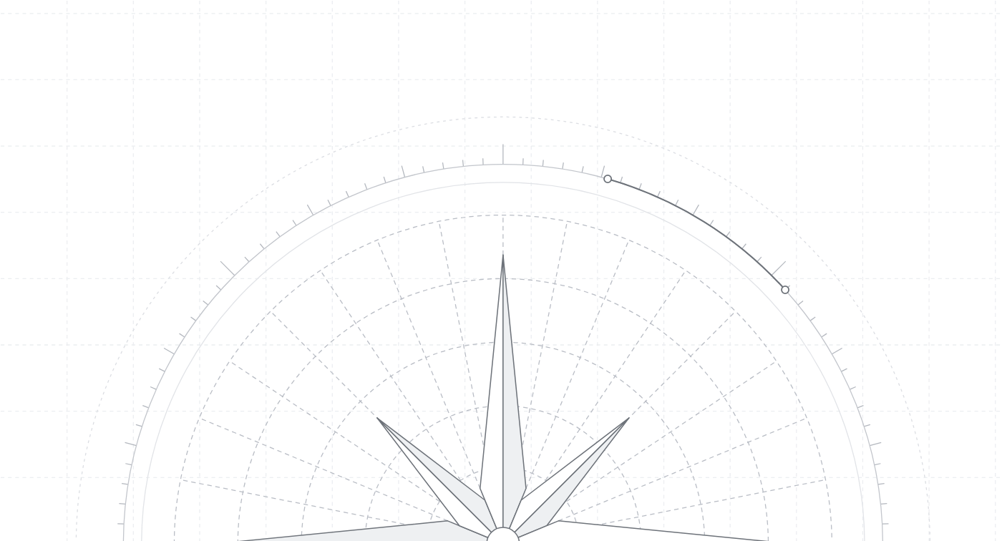












[ 05 · LINE WORK, LABELS AND ICONS ]
[ LINE DRAWING ]
[ HATCH ]
[ FRAME AND GUIDES ]
[ FACT SHEET ]
Deskely Extract is now live ›
Talk to sales
Book a demo
Label: JetBrains Mono, caps, +4%,
Grey 500
Announcement pill
Buttons: outline and ink, 6 px radius
Home
Notifications
Tasks
Inspections
Punch
Walkdowns
Register
Drawings
Systems
Templates
Search
External
DESKELY BRAND GUIDELINES · OCTOBER 2026
18

Slide 19
[ 06 ]
Templates
Ready-made layouts for print, email, social and screens. SVG files open in
Figma and Illustrator.
DESKELY BRAND GUIDELINES
19

Slide 20

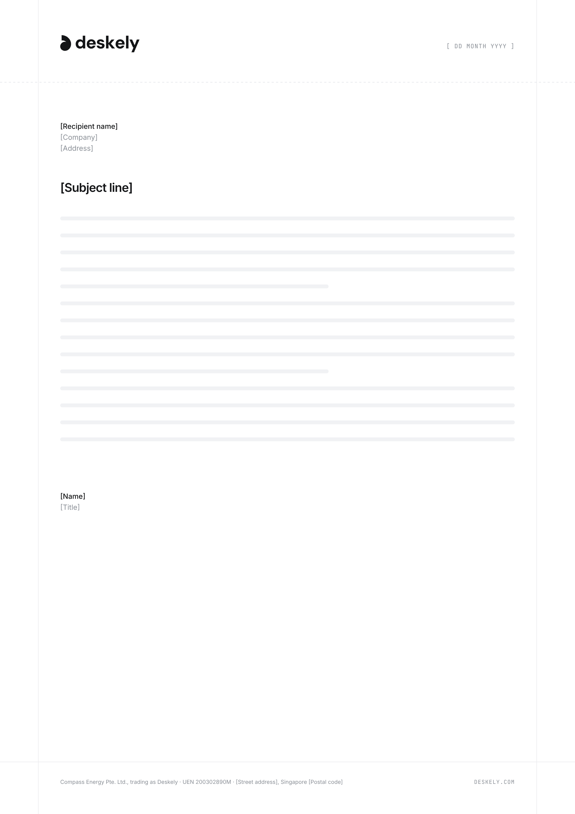
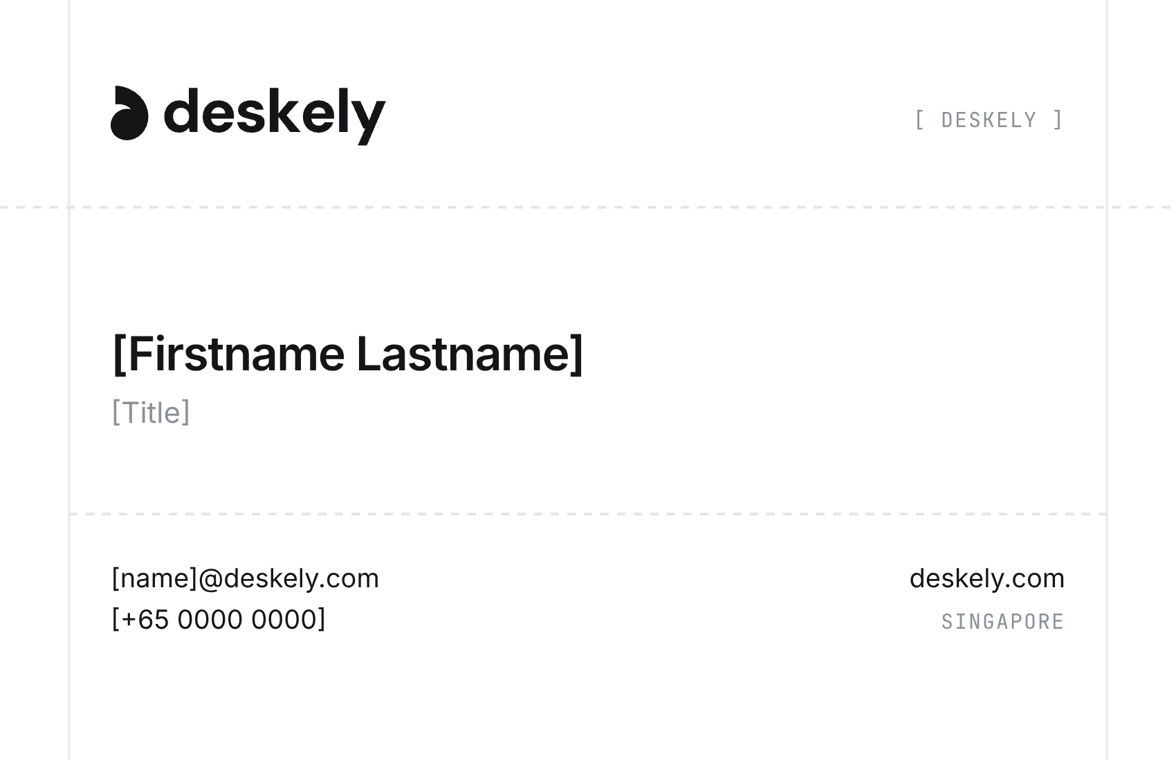
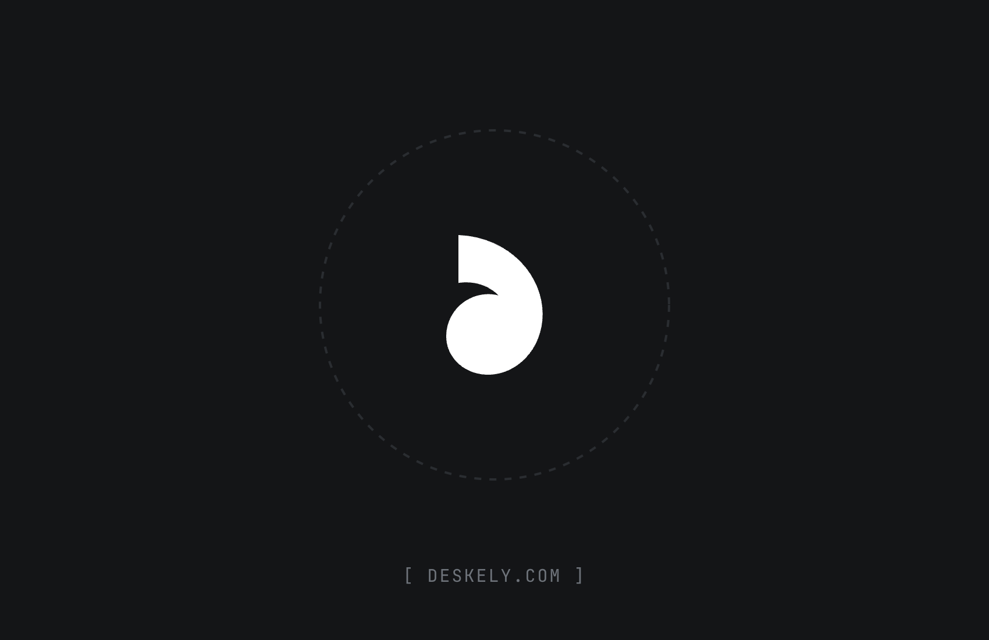
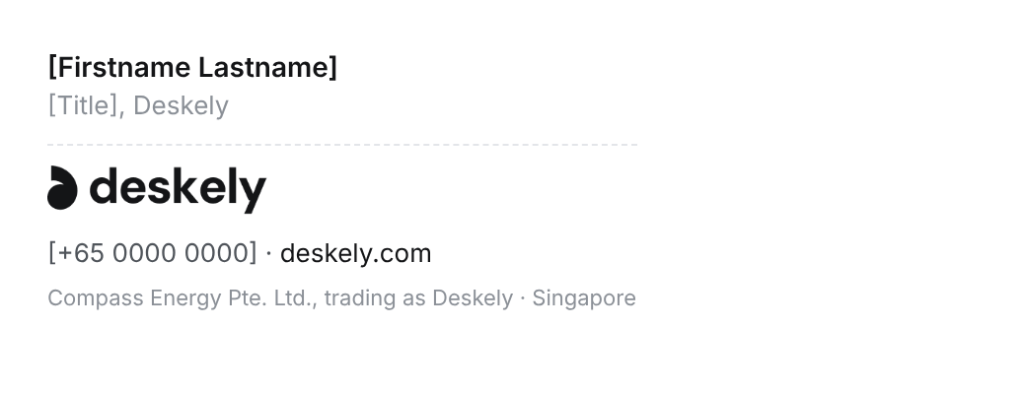
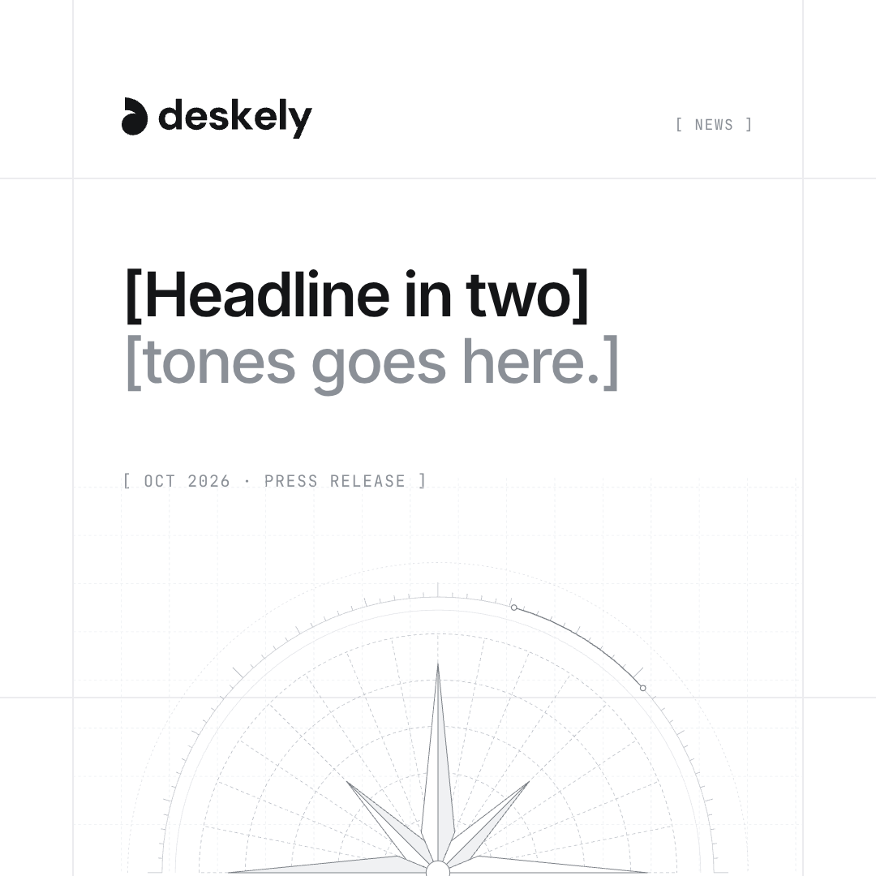
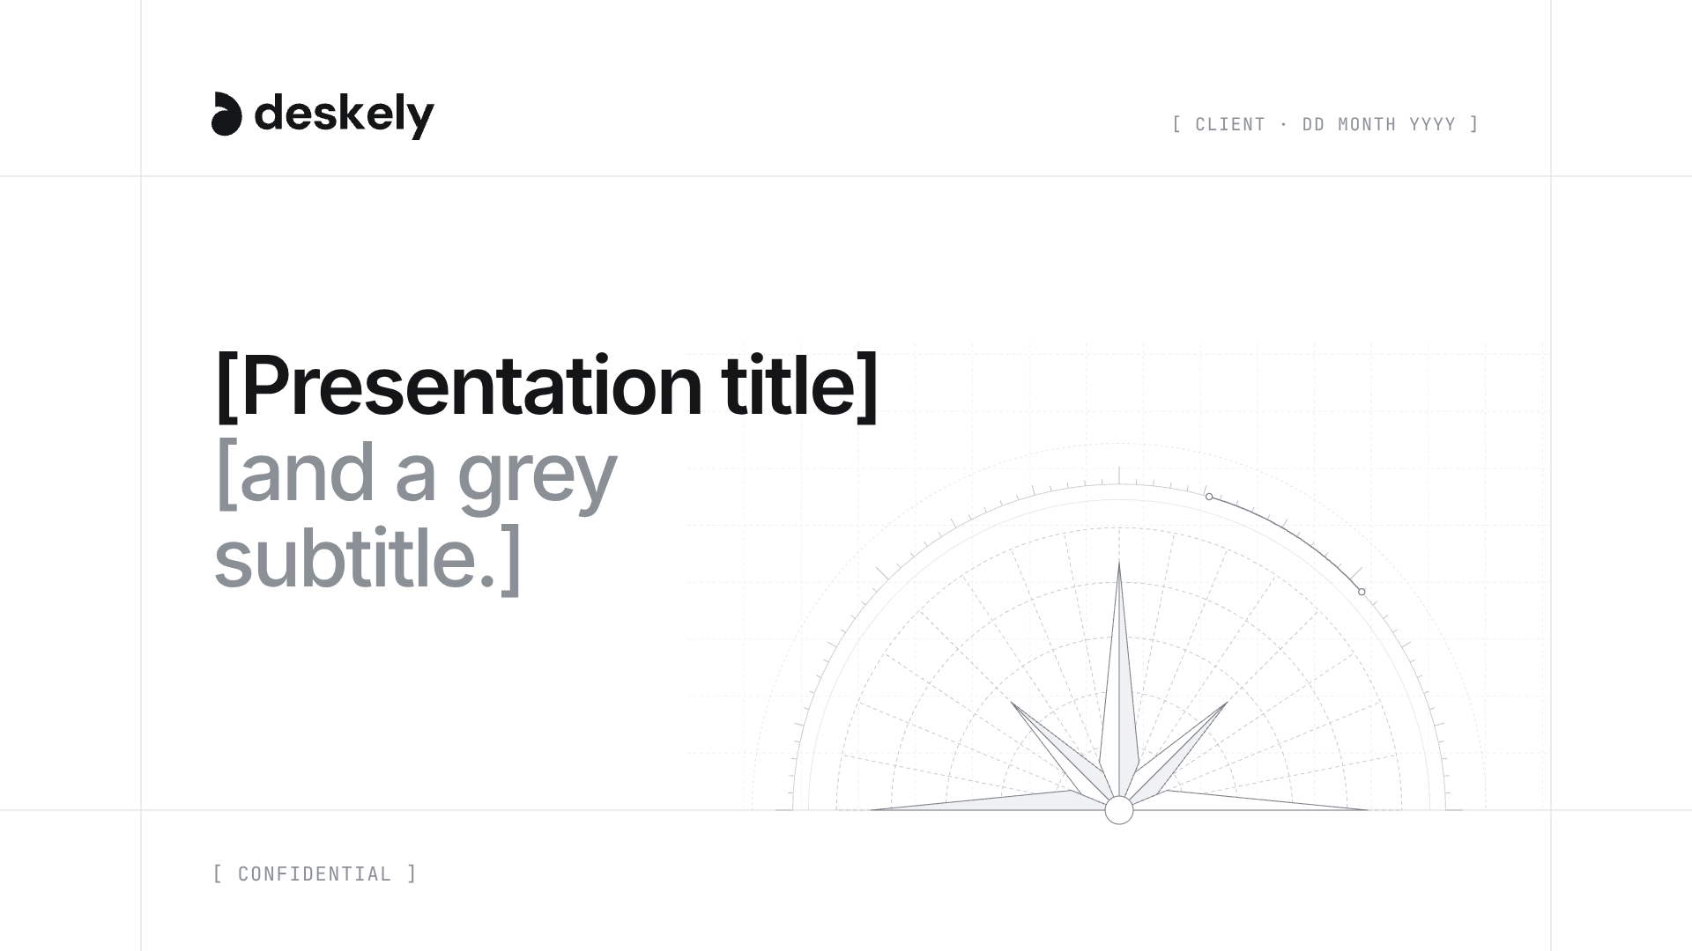
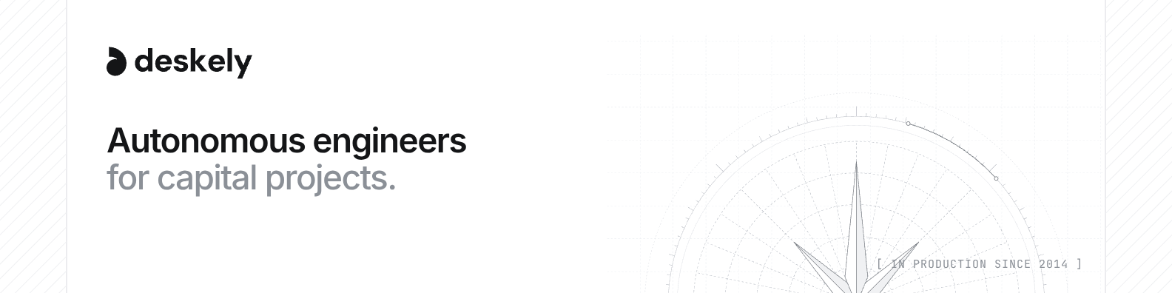
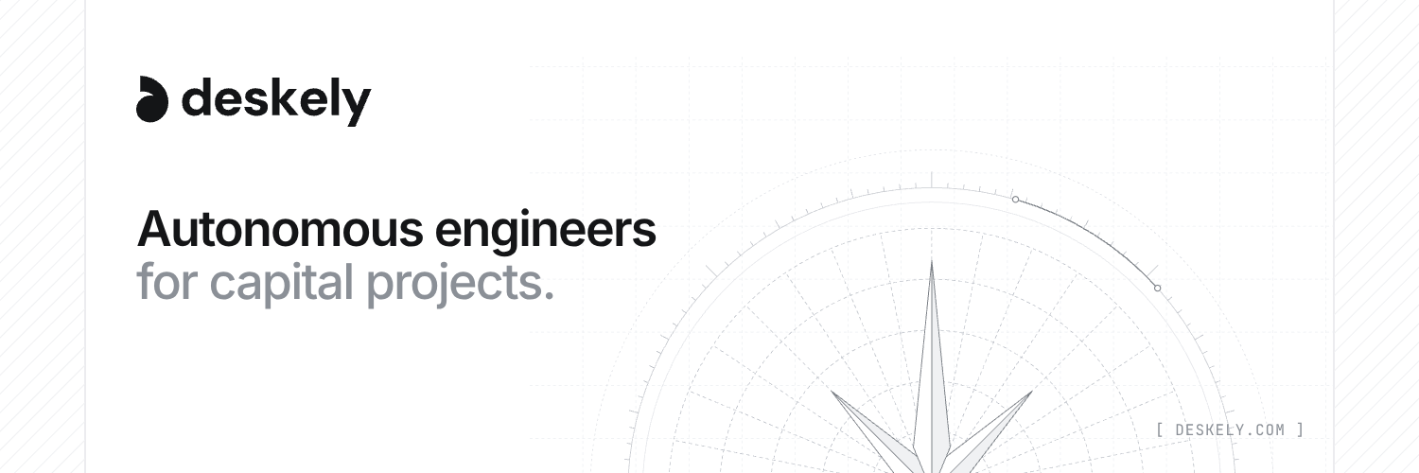
[ 06 · TEMPLATES ]
Business card
Business card, front
Letterhead
Email signature
LinkedIn banner
X header
Social post
Slide cover
DESKELY BRAND GUIDELINES · OCTOBER 2026
20

Slide 21

[ PRESS@DESKELY.COM · DESKELY.COM/COMPANY/MEDIA ]

